Slide 1
SASK LONG COVID PARTICIPANT PORTAL
CMPT 371 - Team 2 ID 5&6

Slide 2
Responsibilities
Roles | Responsible person
Project Manager | Jeet
Build Manager | Riley
Risk Officer | Hari
Dev Lead | Herve
Test Lead | Ini
Developers | Sasthi and Riley
Testers | Chi and Vaidehi

Slide 3
Requirements Set for this deliverable
Refactor the code base with better file separation
Organize Backend code by using separate files for api calls that serve specific functionality.
Add more comments throughout the code base
Enable Admin to upload participant data to the database using the upload-data button on the admin interface.
Allow Admins and participants to log out of the system, and enable Participants to approve/reject users
Integrate Smoke tests, perform more integration testing of the system
Perform coverage testing to see how much code has been tested.

Slide 4
Retrospective Inspection
Team met for retrospective inspection after last deliverable.
Discussed key retrospective questions and noted major issues from previous deliverable.
Discovered several things were not done correctly and had to change approach.

Slide 5
Current State of the system
Login/ Registration system verifies user is logged in before allowing access to data
Admin can login to admin account, see all users, remove a user, and approve a pending user to register
Admins can also upload csv files for participants
The admin can now generate registration link after participant request
When the user logs into the dashboard they get a view of their survey data in tables and a graph
Security increased to prevent unauthorized access to page through urls
Notes:
After signing in from the home page, the user will be directed to the dashboard.
When the Register Now button is clicked, it leads to the registration page, which is currently a dead end as we do not yet have clarification on if we would be handling registration from our end and have someone authenticate it, or if someone (outside our system) does the registration for every participant and gives them their registration details.

Slide 6
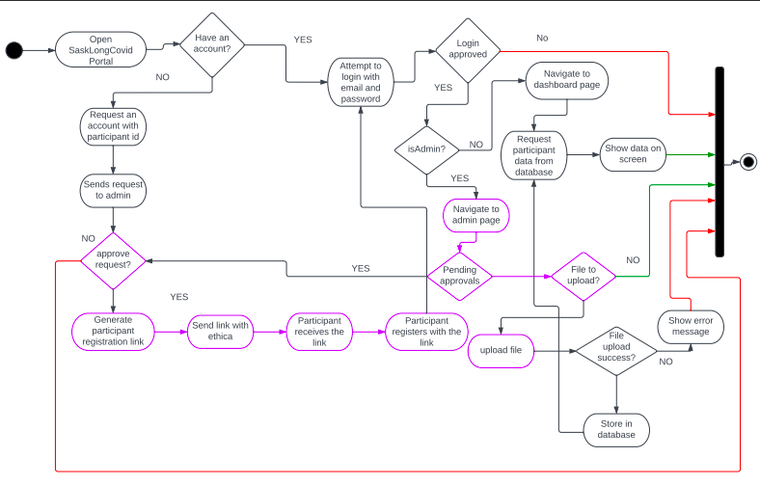
Activity Diagram

Slide 7
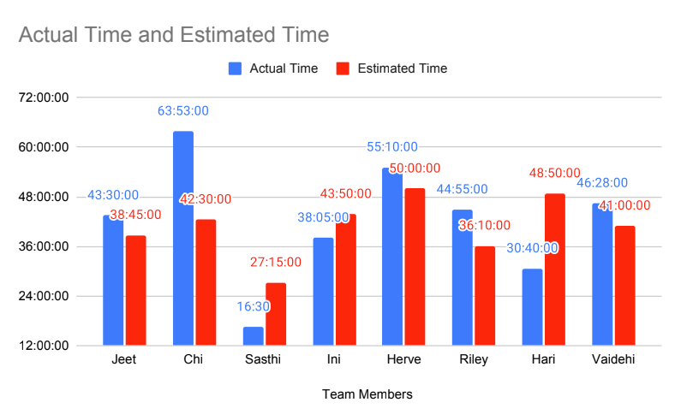
Actual vs. Estimated Time

Slide 8
Issue Tracking
Make good and frequent use of Github Issues to track tasks, known failures, and plans to resolve them
This is also the place to discuss code quality, what needs to be fixed/changed before it can be merged, and can be opened again if issues resurface
Anytime a new problem is found the person that found it should be making a new issue on Github and assigning it to whoever is supposed to fix it if they have an idea (even if that person is themself).
All pushes to dev will notify the entire team

Slide 9
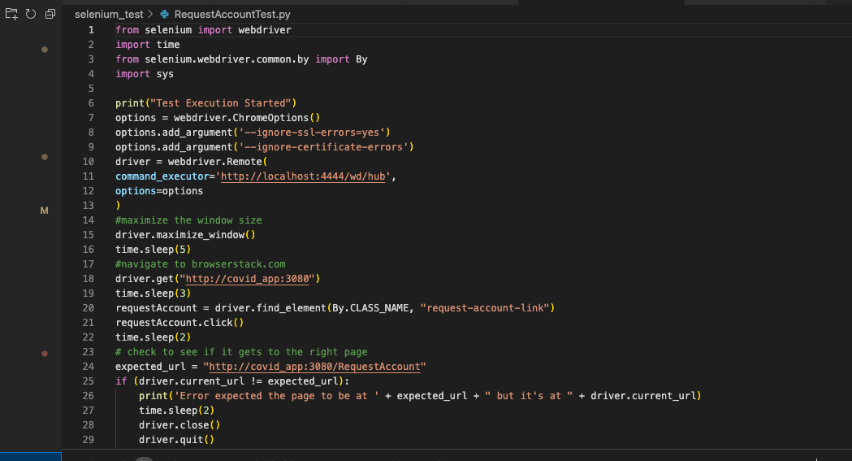
Smoke Tests
Integration testing performed with Selenium, testing tasks that use multiple components
Automation mimics user actions to see how system handles scenarios, such as login
Ensures seamless interaction between components

Slide 10
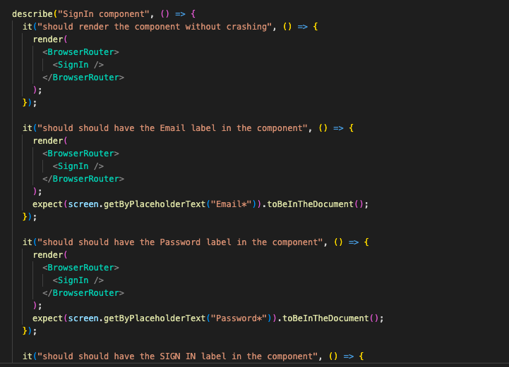
Testing
Unit and UI testing on individual components using React Testing Library and Jest
Tests written before feature development in a Test-Driven Development (TDD) approach

Slide 11
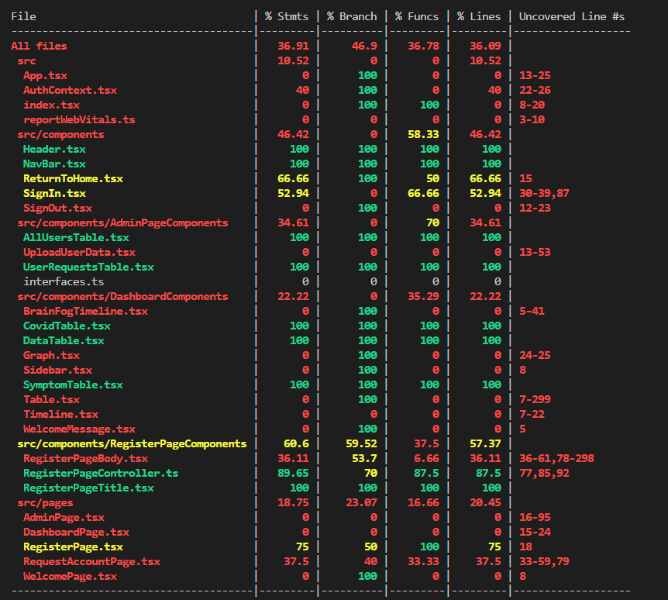
Test Coverage
Test coverage analysis performed using React Testing Library
Analyzes how much of the codebase is covered by tests
Identifies areas for further testing to improve system reliability

Slide 12
Peer Reviews and Code Reviews
Pull requests served as spaces for discussion
We conducted several code reviews and pair programming sessions
For peer reviews, our team met over Discord and split up into smaller teams to go over artifacts and comment on it.
The peer review contains a summary of the artifact, comments on what the person did good and what improvements they can make.

Slide 13
Future Plans
Add more user view features
Create single graphs for each major symptoms (fatigue, brain fog , etc…)
Improving security in transfer of data
Improving test coverage

Slide 14
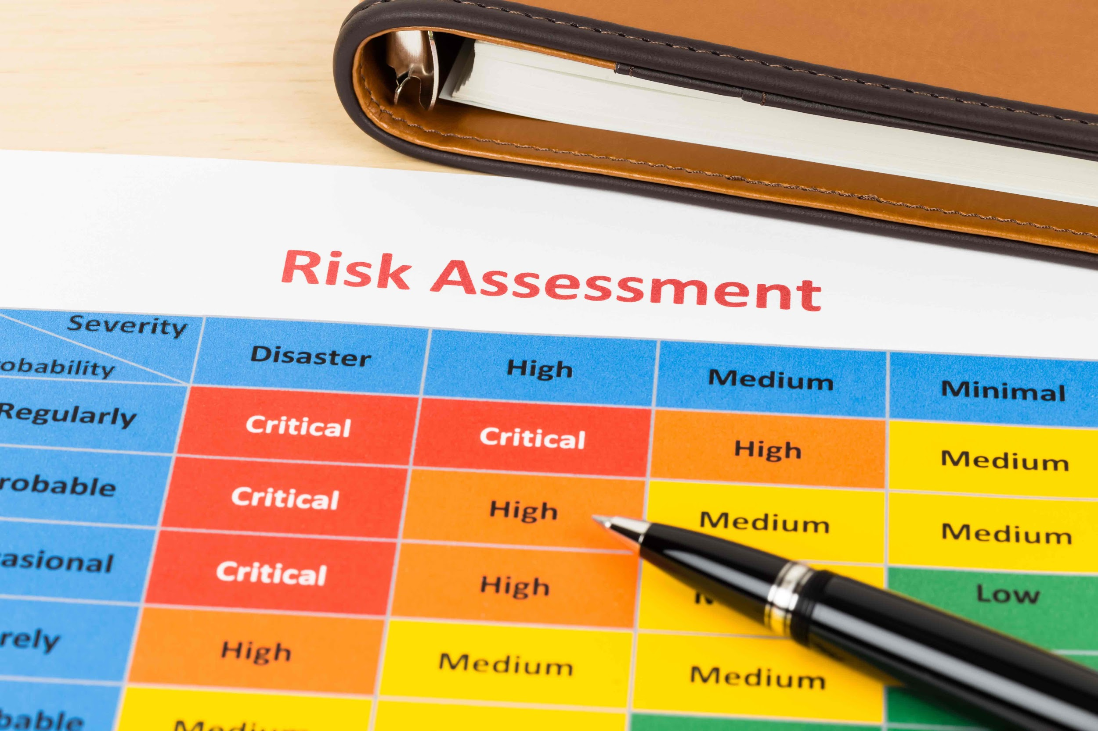
Risk Suggestions
Summary
During the reporting period, several risks were identified, including technical, schedule, personnel, and external risks. High-priority risks include poor quality code, scalability, stability, data breach, and integration issues. Mitigation strategies and responsible parties have been assigned for each risk.
Risk Trends and Changes
During the reporting period, several risks were identified, including technical, schedule, personnel, and external risks. High-priority risks include poor quality code, scalability, stability, and data breach. Mitigation strategies have been assigned for each risk.
Action Items and Recommendations
Ensure the system architecture is designed with scalability in mind.
Improve testing processes to identify and address stability issues.
Strengthen security measures to prevent data breaches and medical identity theft.
Conduct thorough testing and monitoring to address integration issues.

Slide 15
Summarized Risk Table
The following table summarizes the risks identified for the project, including the risk description, category, likelihood, impact, priority, and mitigation strategy.
Risk Description | Category | Likelihood | Impact | Priority | Mitigation Strategy
Poor quality code | Technical | Medium | High | High | Implement code reviews and enforce coding standards
Scalability | Technical | Medium | High | High | Plan for growth and use scalable technologies
Stability | Technical | Medium | High | High | Conduct thorough testing and monitor system health
Poor Planning | Schedule | Medium | Medium | Medium | Improve project management and set clear milestones, deadlines, and priorities
Lack of skills | Personnel | Low | Low | Low | Provide training and resources to enhance skills
Human error | Personnel | Medium | Medium | Medium | Implement processes and guidelines to minimize error
Data breach | External | Low | High | Medium | Implement processes and guidelines to minimize error
Legal and regulatory compliance | External | Medium | High | High | Ensure compliance and conduct regular audits

